Slide 1
Push Notifications

Slide 2
What are they?
Messages sent from external source
Works even when app isn’t currently running in the foreground/background
Messages are sent in near real-time
Resource friendly
No polling needed!

Slide 3
How are they useful?
Provides a way to engage with your users
Enriches user experience
Keeps users within your app’s ecosystem
Brings the user back to your app

Slide 4
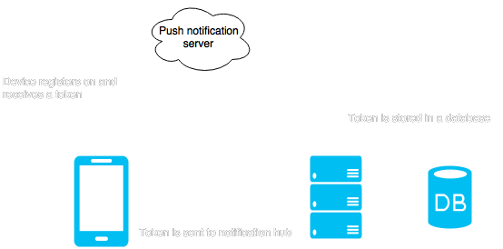
How does it work?

Slide 5
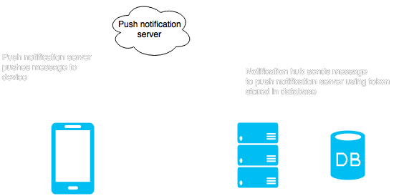
How does it work?

